Slide 1
CAREER AI AGENT
IBM HACKATHON PROJECT
Presented By:
Student name :PRATIKSHA SURYAKANT BHOSLE
College Name & Department :Dwarkadas J. Sanghvi College of Engineering &
BACHELOR OF MECHANICAL ENGINEERING

Slide 2
OUTLINE
Problem Statement
Technology used
Wow factor
End users
Result
Conclusion
Git-hub Link
Future scope
IBM Certifications

Slide 3
PROBLEM STATEMENT
Students often struggle to make informed career decisions due to fragmented access to career guidance, low awareness of their own skills and interests, and the rapidly changing job market. Traditional career counseling is often generalized, manual, and lacks the personalization required for today's diverse academic and career paths.
The challenge is to create an intelligent, autonomous career agent that continuously monitors student interests, academic data, and real-time industry trends. The goal is to deliver tailored, dynamic career suggestions that empower students to make confident, future-ready choices — without relying solely on human intervention.

Slide 4
TECHNOLOGY USED
IBM Watsonx AI Studio
IBM Cloud Lite Services
IBM Granite Foundation Model
Natural Language Processing (NLP)
Vector Indexing for Career Content

Slide 5
WOW FACTOR
Unlike static or manual career guidance tools, this AI agent offers a fully autonomous and personalized experience. It adapts in real-time based on:
User preferences and profile
Current job market and skill demand
Dynamic resume parsing and career suggestions
Key Unique Features:
Resume-based job role matching
Personalized skill and course recommendations
Real-time labor market trend integration
Dialog-based smart conversations via IBM Watson Assistant
Career pathways based on education level and interests

Slide 6
END USERS
High school and college students
Career counselors and training institutions
Parents and educators
Professionals seeking career transition

Slide 7
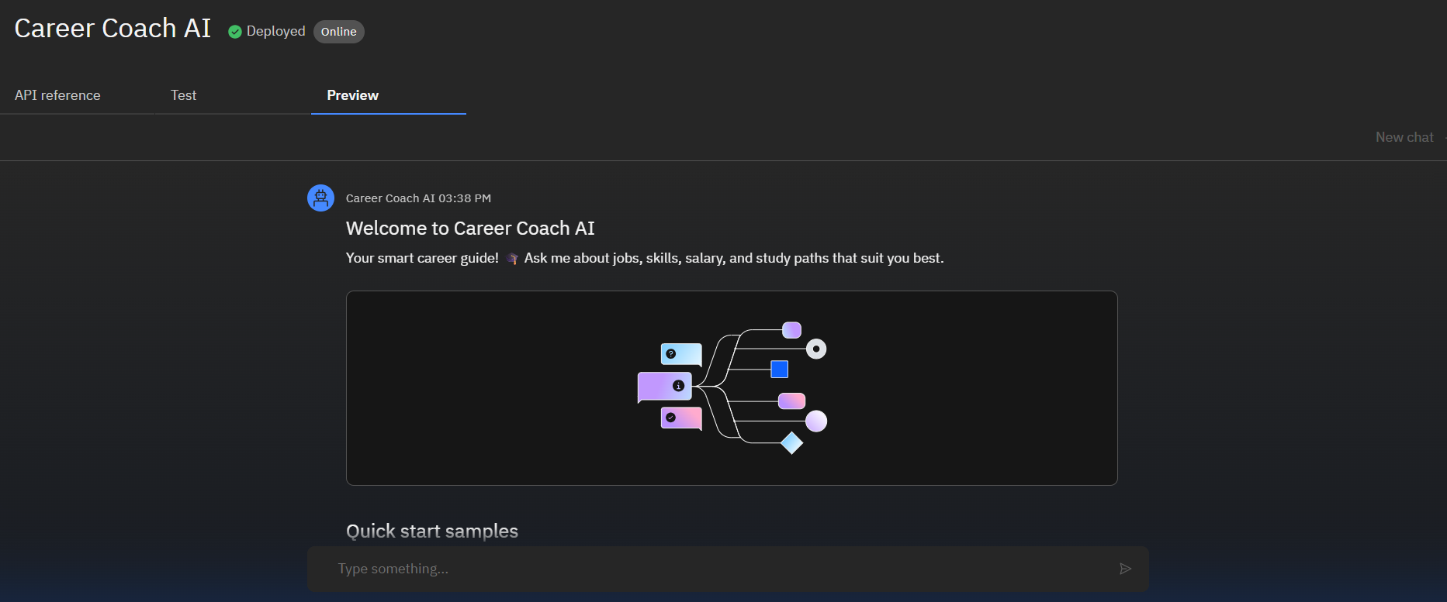
RESULT

Slide 8
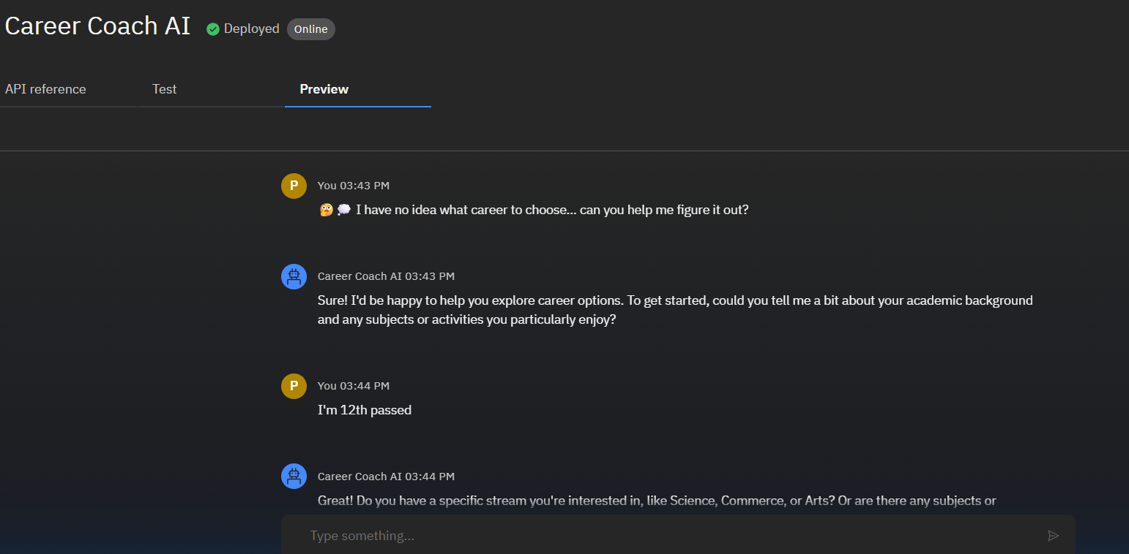
RESULT

Slide 9
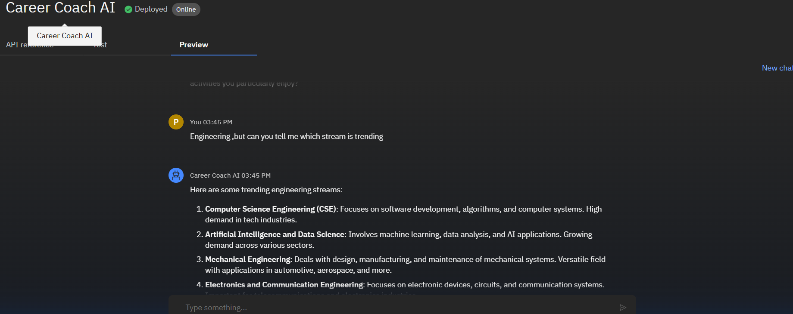
RESULT

Slide 10
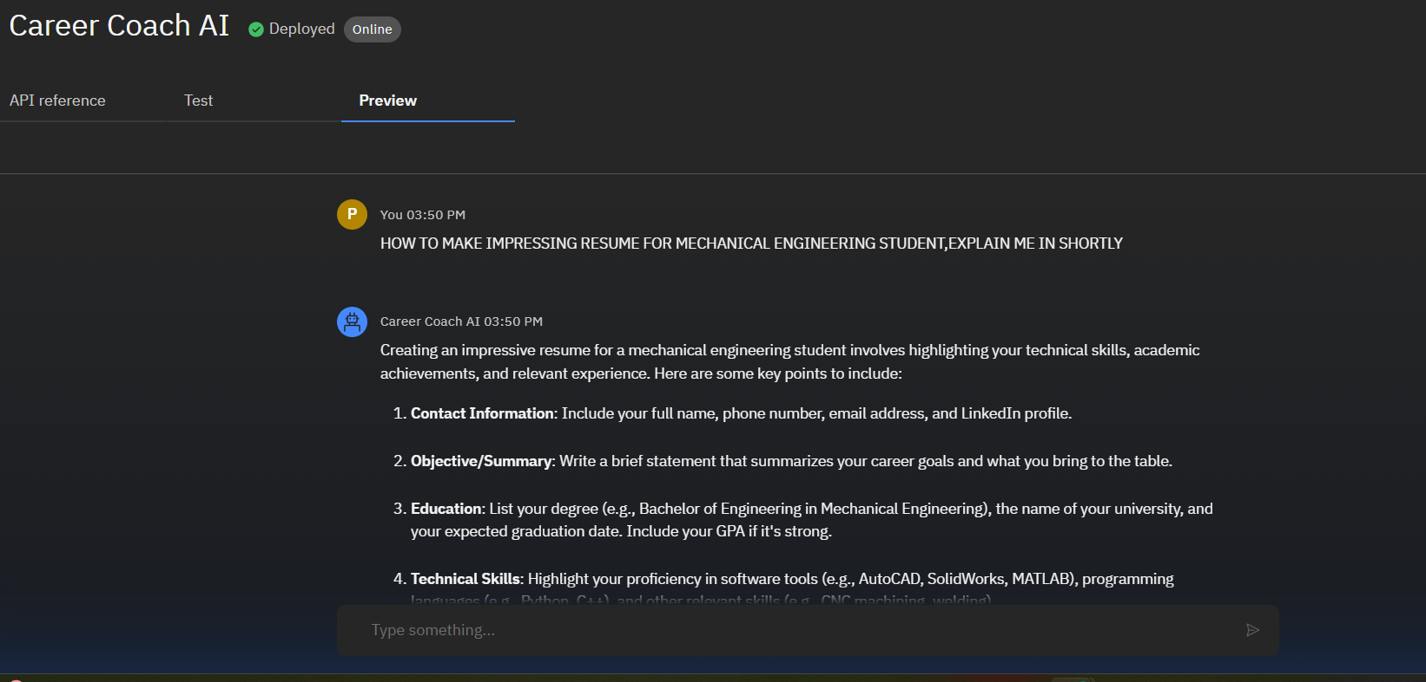
RESULT

Slide 11
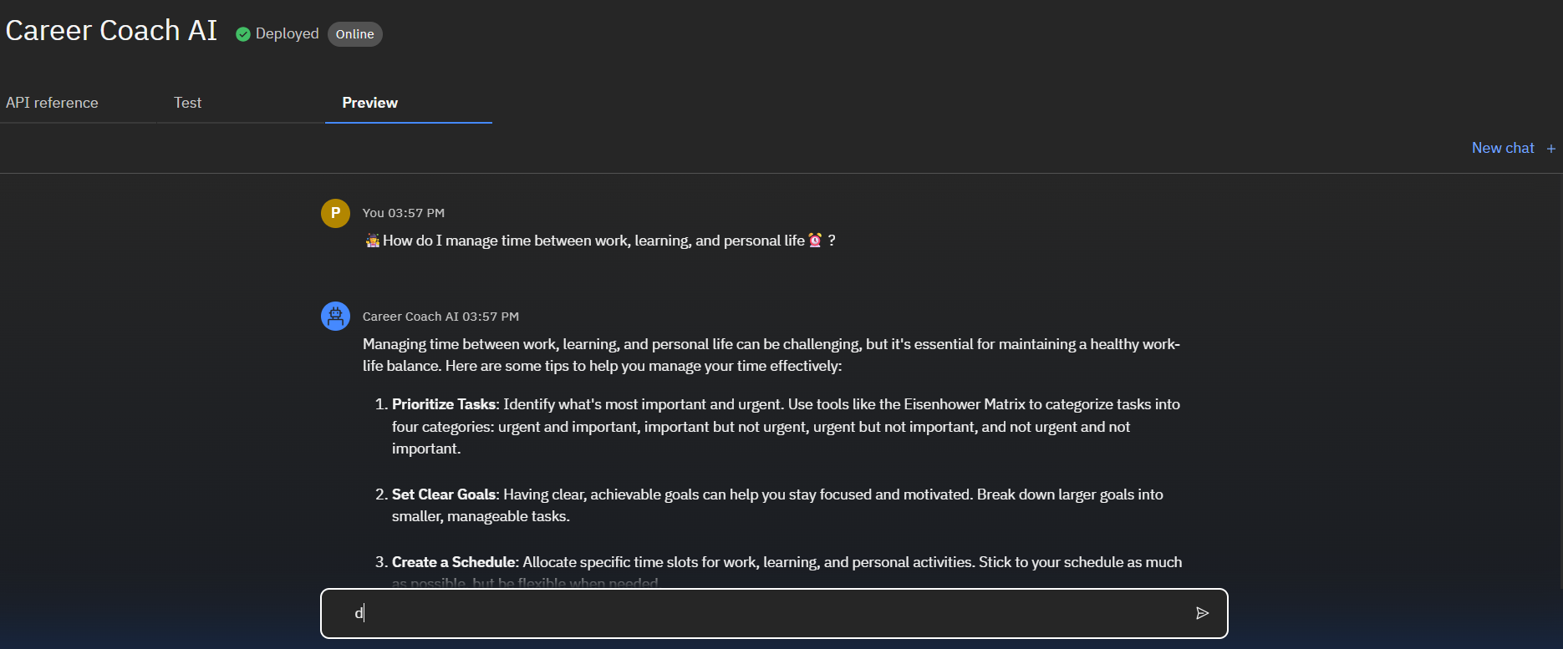
RESULT

Slide 12
CONCLUSION
This intelligent career agent bridges the gap between traditional counseling and modern AI-driven guidance. It empowers students and job seekers to discover career paths that align with their skills and ambitions, while reducing the dependency on human advisors. The system offers scalability, personalization, and automation — key ingredients for next-gen counseling.

Slide 13
GIT-HUB LINK

Slide 14
FUTURE SCOPE
Multilingual support for regional language users
Integration with voice-based virtual assistants
Real-time skill gap detection and course recommendations
Automatic profile updating via LinkedIn scraping (future vision)
Integration with online learning platforms (Coursera, edX)

Slide 15
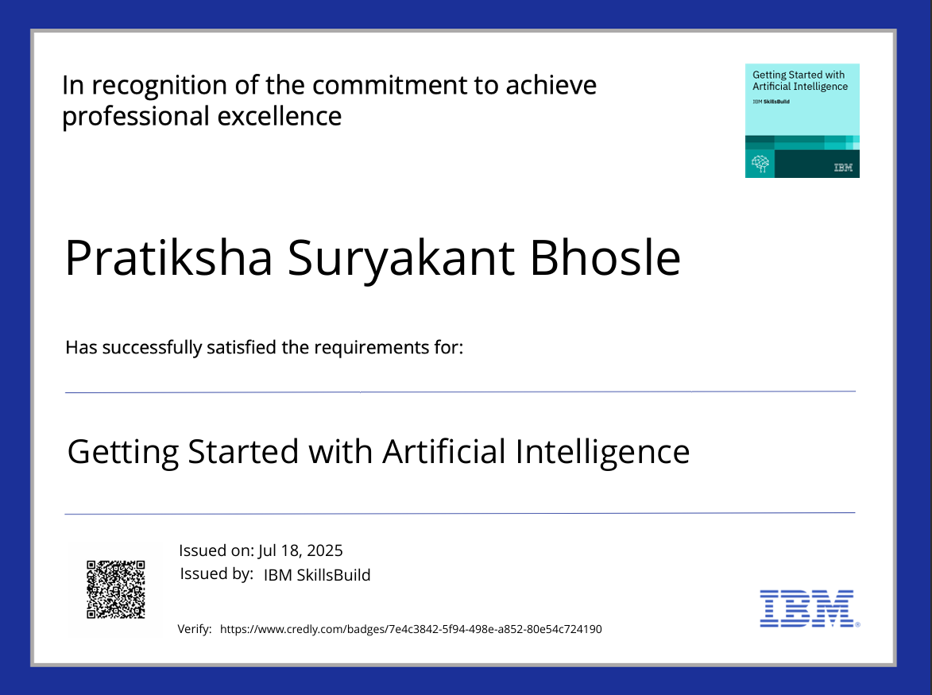
IBM CERTIFICATIONS

Slide 16
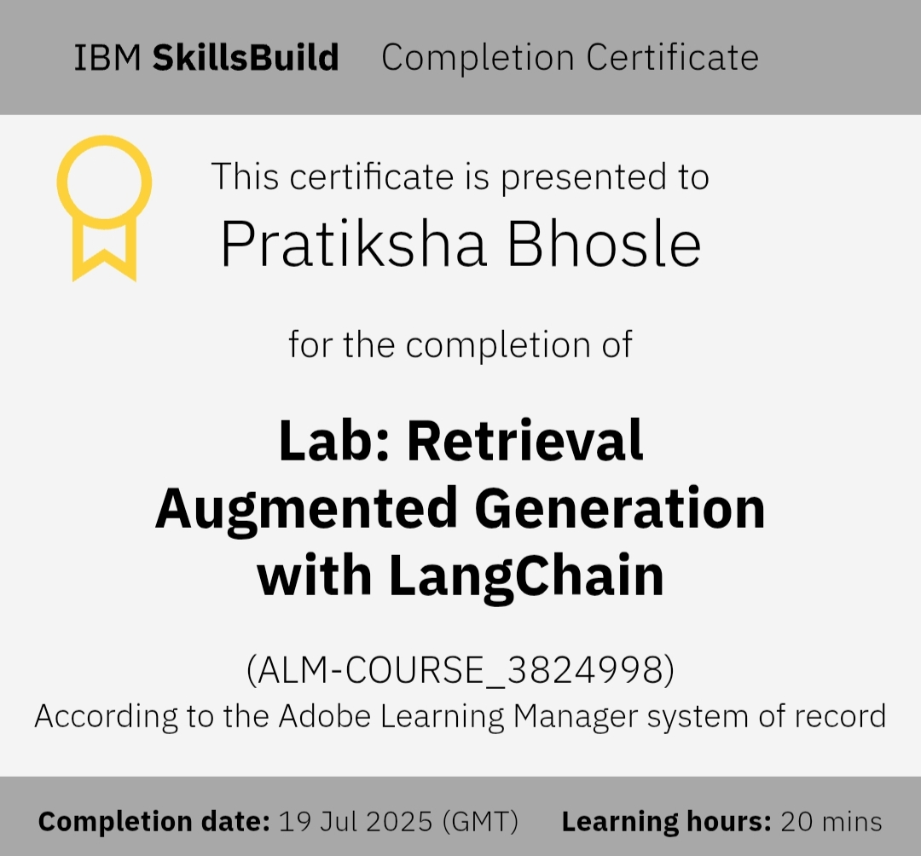
IBM CERTIFICATIONS

Slide 17
THANK
YOU

